Slide 1
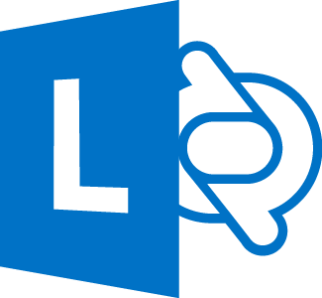
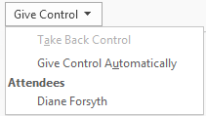
Give control of your sharing session to others
Allow others to flip through slides, contribute information and make changes to a whiteboard or OneNote, PowerPoint or other kind of file, or demonstrate a program with just a couple of clicks. Take back control at any time.
On the sharing bar at the top of the screen, click Give Control.
Click the name of a person under Attendees to give them access, or click Give Control Automatically to automatically give access to anyone who asks for control of your desktop.
Lync 2013 for Office 365 Quick Reference
Sharing and Collaboration
With Lync you can start collaborating without having to schedule a meeting. You can start an impromptu meeting, share something on your computer (a file, a website, and so on), take and share notes, brainstorm together on a whiteboard, give or work on a PowerPoint presentation, or send a file.
You can also schedule a Lync Meeting and share and collaborate from there (for details, go to office.com, and see “Set up a Lync Meeting“ and ”Join a Lync Meeting” for Lync 2013 for Office 365).
Share your desktop or a program
Take back control of a sharing session
To take back control of your desktop or program, click Give Control again.
If Give Control Automatically is selected, click it to clear it. To take back control from a person, click Take Back Control.
In your Contacts list, double-click a contact to start an IM conversation, and add people or groups by dragging them into the window from your Contacts list. Or, join a scheduled Lync Meeting.
Point to the present (monitor) button, and, on the Present tab, either:
Click Desktop to show the entire content of your desktop.
Click Program if you want to share just an open program, and then double-click the program you want.
(Optional) To add audio, click the phone button.
(Optional) To add video, click the camera button.
Select who can download shared files
In a scheduled meeting, while you’re presenting, you can restrict who can download a copy of the file you’re sharing, if, for example, the information isn’t final or is confidential.
During a sharing session, point to the present (monitor) button, and then click the Manage Presentable Content button. TIP: You know you’re sharing when you see the Sharing bar at the top of your screen.
Click the Permissions menu, and then select one of the following:
Organizer, to allow only the person who set up the meeting to download the file.
Presenter, to allow only the people who the organizer set up as presenters to download the file.
Anyone, to allow all participants to download the file.
© 2012 Microsoft Corporation. All rights reserved.

Slide 2
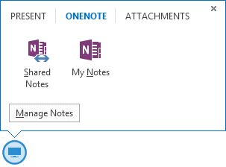
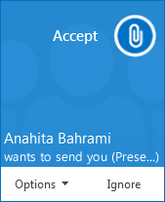
Share notes
Often, you want to take notes during a meeting. If you use OneNote, you can take notes that everyone can see, work collaboratively on those notes, and/or, share notes you’ve already taken.
In a conversation window, point to the present (monitor) button, and click the OneNote tab.
Click Shared Notes, and then, in the note picker, select a notebook or note page, or click New Notebook to create a new one.
The page you select docks on your desktop, and the other participants receive a notification about the shared notebook. Let them add notes, if you want (see the section “Give control” for details).
Share a PowerPoint presentation
Point to the present (monitor) button, and, on the Present tab, click PowerPoint.
Do any of the following:
To move the slides, click Thumbnails, then click the slide you want to show, or use the arrows at the bottom of the meeting window.
To see your presenter notes, click Notes.
To use highlights, the laser pointer, and other annotation tools, click the Annotations button on the upper-right side of the slide. Annotating doesn’t change the actual file, although, you can save an annotated copy, if you want.
To prevent someone from skipping ahead or using annotations, in the meeting window, click More Options, click Lync Meeting Options, and then select the permissions level for the participant(s)
Transfer a file
Use the file transfer option to send documents to your contacts in an instant message.
In your Contacts list, double-click a contact’s name to open an IM conversation.
Drag the file from your computer onto the conversation window, or click the present (monitor) button and use the Attachment tab.
Lync sends a file transfer invitation to the recipient, and the file is sent if the invitation is accepted.
TIP You can also drag the file onto a contact’s name, which sends a notification to the recipient to accept or decline the file transfer.
Share a whiteboard
A whiteboard is a blank area where you can type notes, draw, or import images that meeting participants can work on together. It’s great for brainstorming.
In a conversation window, point to the present (monitor) button, and, on the Present tab, click Whiteboard.
Use the annotation toolset on the right side of the whiteboard for highlight, stamps, laser pointer, writing, drawing, and other tools.

