Slide 1
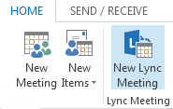
Join a Lync meeting
In the meeting request, click Join Lync meeting or click Join Online in the meeting reminder. Or, if the meeting request includes call-in information, you can call in to the meeting from a phone.
If you’re joining by using Lync, on the Join Meeting Audio window, select one of these options.
Lync 2013 for Office 365 Quick Reference
Lync Meetings
Schedule a Lync meeting
You can schedule a Lync Meeting by using the Outlook add-in for Lync, if you use Outlook. If you don’t use Outlook, set up meetings by using Lync Web Scheduler, available at https://sched.lync.com.
To schedule a meeting with Outlook:
Open your Outlook calendar, and on the Home tab, click New Lync Meeting.
In the meeting request, add recipients, a subject, agenda, and date/time.
The meeting request contains the meeting link and, if your account is configured for dial-in conferencing, audio information that the participant
can use to join the meeting.
Use Lync (full audio and video experience) | You can use computer audio and video with your computer’s built-in devices, or a headset and camera.
Call me at: | Lync calls you at a number you provide.
Don’t join audio | Select this if you prefer to call in to the meeting audio with a phone. Use the conference numbers and ID in the invitation to dial in.
Do I need a PIN, work number or extension?
Not always. Most of the time when you call into the meeting, you get connected right away. You need a PIN and extension only if:
You’re the leader (organizer) of the meeting and calling from a phone that is not connected to your Lync account; such as a cell phone.
You’re an attendee, but the meeting is secured and you need to be identified before joining.
If you’re prompted for a PIN, use your phone dial pad to enter your number and PIN.
If you don’t remember your PIN, click Forgot your Dial-in PIN in the meeting request, and the follow the instructions on the page to reset.
Set meeting options
You can customize some meeting options, including who has access, present, and share video, for an individual meeting. The options you can set vary depending on whether you use Outlook.
If you use Outlook, set meeting options from the meeting request for a meeting you set up.
Open the meeting request, and on the Home tab, click Meeting Options, and then in Access and Presenter options and Audio and Phone options, choose the appropriate selections.
If you don’t use Outlook, you can
change some options for participants
during a meeting you’re a presenter
in. For details, see Manage participants
later in this guide.
© 2012 Microsoft Corporation. All rights reserved.

Slide 2
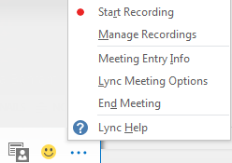
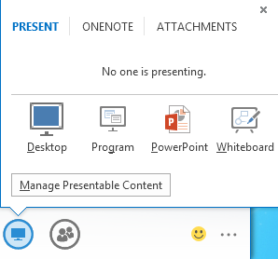
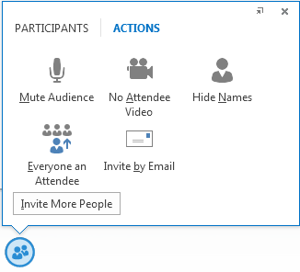
Record and playback the meeting
Lync recording captures audio, video, instant messaging (IM), program sharing, PowerPoint presentations, and whiteboards.
In the meeting window, click More Options, and then click Start Recording.
Use the controls at the bottom of the meeting room to pause, resume, or stop the recording.
After the recording is stopped, Lync automatically saves it in a format that plays in Windows Media Player and Zune.
To play, rename, or delete a recording, click Manage Recordings on the More Options menu, and click your selection. You can also click Browse to go to the location of the recording and make a copy of the file to post on a shared location for others to view.
Share your desktop or a program
During a Lync meeting, you can share your desktop or a specific program.
In the meeting window, point to the presentation (monitor) button.
On the Present tab, click:
Desktop to show the entire content of your desktop.
Program, and double-click the program you want to share.
(Optional) Click Give Control on the sharing toolbar at the top of the screen to share control of your sharing session with another participant.
NOTE You can take control back at any time by clicking Give Control, and then Take back control.
When you have finished presenting, click Stop Presenting on the toolbar.
Manage participants
In the meeting window, point to the people button, and do any of the following:
To manage a participant, on the Participants tab, right-click the person’s name, and use the options to mute, unmute, remove, and so on.
To manage all, on the Actions tab, click:
Invite More People to add participants.
Mute Audience to eliminate background noise.
No Attendee Video to block attendees from starting their video.
Hide Names to hide the names on the pictures.
Everyone an Attendee if you have too many presenters.
Invite by Email to send email invitations to additional people.
Share a PowerPoint presentation
Point to the presentation (monitor) button.
On the Present tab, click PowerPoint, and upload the file in the meeting.
(Optional) Do any of the following:
To move the slides, click Thumbnails, and then click the slide you want to show, or use the arrows at the bottom of the meeting window.
To see your presenter notes, click Notes.
Click the Annotations button on the upper-right side of the slide to open the toolbar and use highlights, stamps, laser pointer, and so on.

