Slide 1
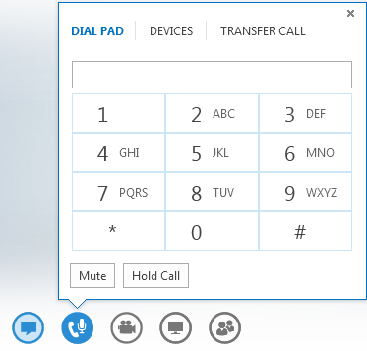
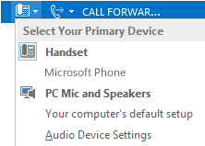
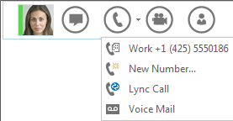
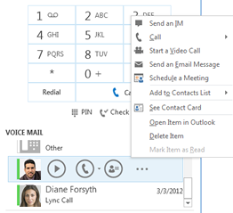
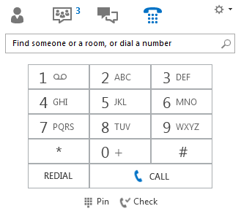
Use audio call controls
Pause on the phone/mic button to access the controls:
To put the call on hold, click Hold Call.
Click Mute to mute your audio.
To send the call to another number, click the Transfer Call tab, and choose one of the numbers.
To hang up, click the phone button in the conversation window.
Lync 2013 Quick Reference
Audio
Quick Reference for Voice
Set up your audio device
Before using Lync to make a call or join a conference, set up your audio device and check the quality. You can use your computer’s mic and speakers, or plug in a headset.
Click Select Primary Device on the lower-left corner of Lync, then click Audio Device Settings.
Pick your device from the Audio Device menu, and adjust Speakers and Microphone volume.
Check your voice mail
Click the Phone tab. You’ll see your messages and the caller’s info.
Pause on a voice mail message and click Play.
Click More Options, and select one of the choices, such as:
Open Item in Outlook provides more information about the call.
Delete Item deletes the voice mail from Lync.
Start a Video Call with the contact.
Mark item as Read
Call the contact.
See Contact Card
You can also click View more in Outlook to open the Voice Mail folder for more info.
Make a call
Make a Lync call (computer audio)
Pause on a contact’s picture.
Click the Phone button to call the contact using Lync, or click the arrow next to the Phone button and select a number.
Call using the dial pad
Click the Phone icon in Lync.
Click the numbers on the dial pad or type the number in the search box, then click Call.
Lync calls the number just like a regular phone.
© 2012 Microsoft Corporation. All rights reserved.

Slide 2
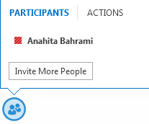
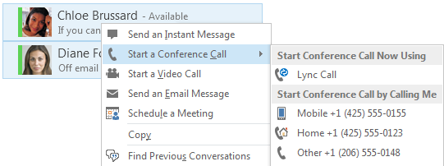
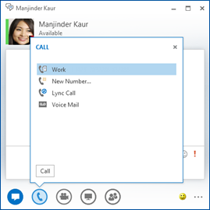
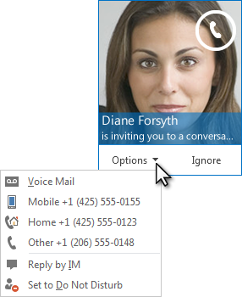
Start a conference call
Select multiple contacts by holding the Ctrl key, and clicking the names.
Right-click the selection , then click Start a Conference Call.
Choose how you want to start the conference call by selecting Lync Call or one of the numbers.
Invite more people to a call
In the conversation window, pause on the People icon and click Invite More People.
Select the invitees from Invite by Name or Phone Number window, and click OK.
Your new invitees receive a request to join your call.
Add audio to an IM conversation
Pause on the Phone icon in the IM window and select one of the numbers.
You have options such as work, mobile, or home (if published) for your contact.
You can also click New Number, and type a number to call.
Answer a call
When someone calls you, an alert pops up on your screen.
To answer the call, click anywhere on the picture area.
Click Ignore to reject the call and send to voice mail.
Click Options to take other actions:
Send the call to Voice Mail.
Reply by IM instead of audio.
Set to Do not Disturb to reject the call and avoid other calls.
To redirect the call to a different number, click the number.

